Slide 1
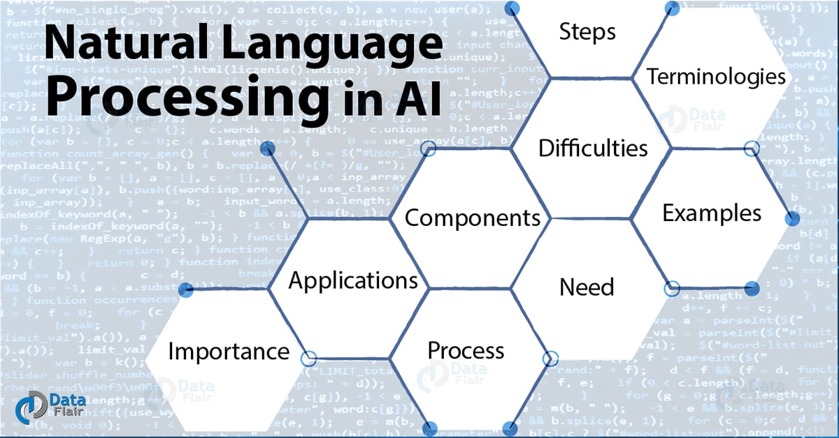
RATINGS PREDICTION
USING NATURAL LANGUAGE PROCESSING
Project By -
Shivani Angadi
(Internship 14)

Slide 2
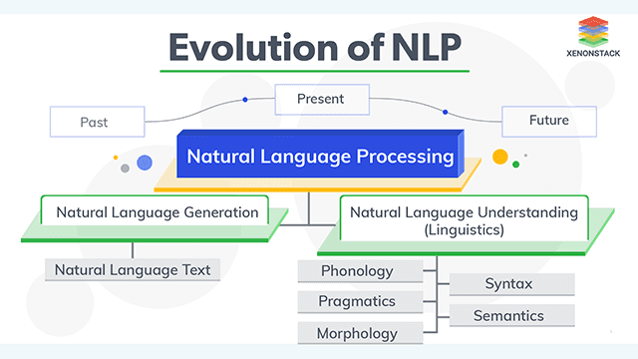

Slide 3
Use Cases of NLP
Translation Application
Fake News Detection
Classifying Emails
Predicting Disease
Error Detection
IVR Application
Sentiment Analysis
Personal Voice Assistant

Slide 4
Project Description
Data Collection
Data of 20,649 records is scrapped from various e-commerce websites such as Amazon & Flipkart.
The data scrapped consists of the reviews and respective ratings of different technical products such as Laptops, Phones, Headphones, smart watches, Professional Cameras, Printers, Monitors, Home theater, Router etc.
Data set consists of two columns - Reviews & Ratings.

Slide 5
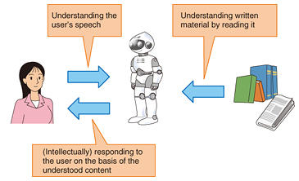
Model Building
After data collection, machine learning model is built.
Before model building, all the data preprocessing steps will involve NLP.
Complete life cycle of data science include steps like -
Data Cleaning
Exploratory Data Analysis
Data Preprocessing
Model Building
Model Evaluation
Selecting the best model

Slide 6
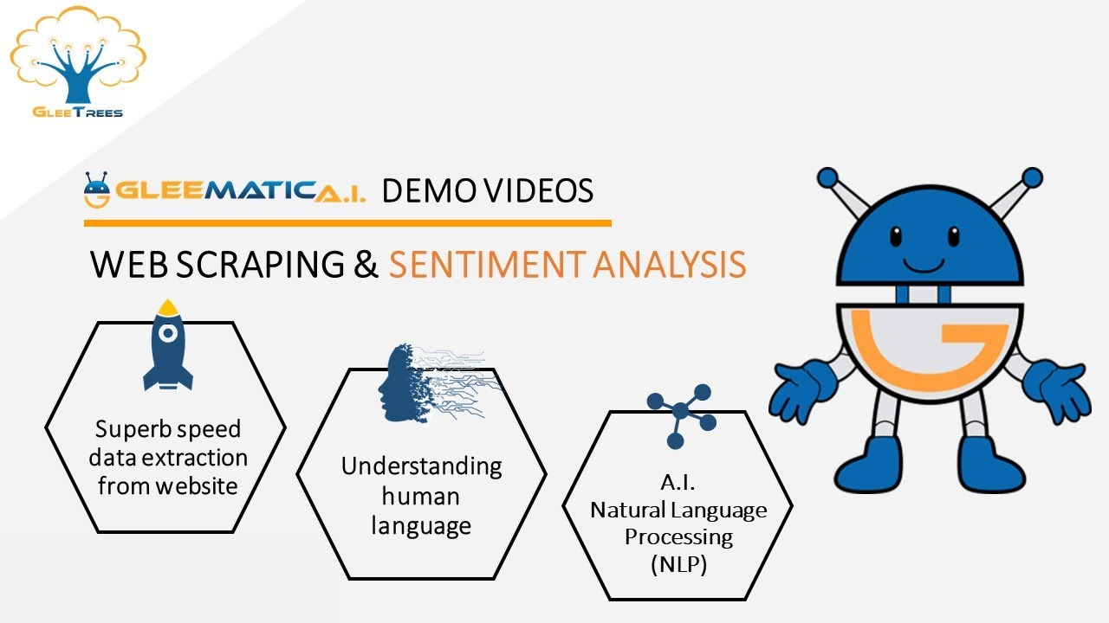

Slide 7
Business Goal
The business goal is to build a website where people write different reviews for technical products.
The rating is out 5 stars and it only has 5 options available 1 star, 2 stars, 3 stars, 4 stars, 5 stars.
The task is to build a machine learning model for the client in such a way that it can predict ratings for the reviews where the rating of the review is not present on their website.
Hence, the aim is to build an application which can predict the rating by seeing the review.

Slide 8
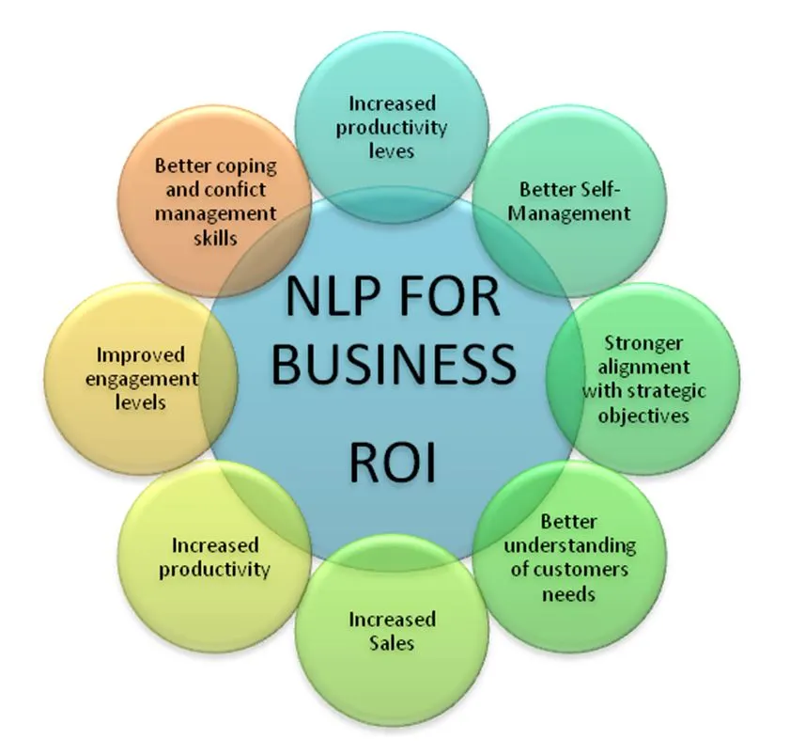

Slide 9
Research & Solution
The research and findings while data scraping has to be made in such a way that an equal number of reviews for each rating needs to be scrapped to achieve balanced nature of data.
Data Scraping should be done in the following way : if data fetched is 10,000 reviews, then all ratings 1,2,3,4,5 should be 2,000 each.
Fetching data from different e-commerce websites can help our model to remove the effect of over fitting. The task is based on Sentiment Analysis.

Slide 10
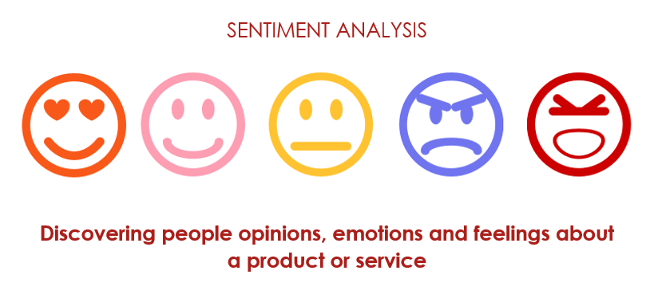

Slide 11
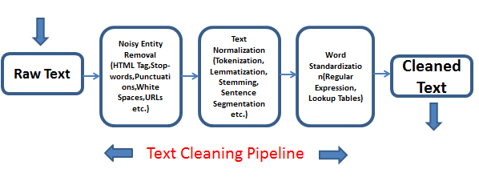
Text Pre-Processing

Slide 12
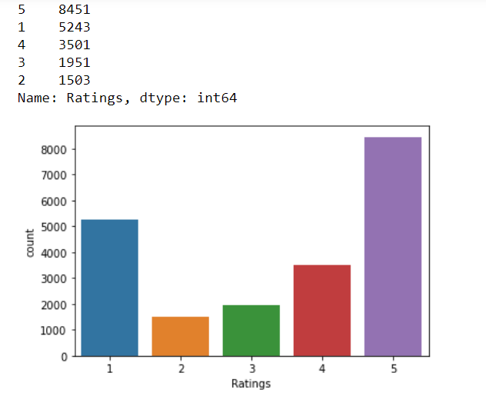
Data Distribution for each Class Label
Maximum records are for Rating 5 & Rating 1 and least are for Rating 2 which indicates that the data scrapped is not balanced and contains imbalanced data set.

Slide 13
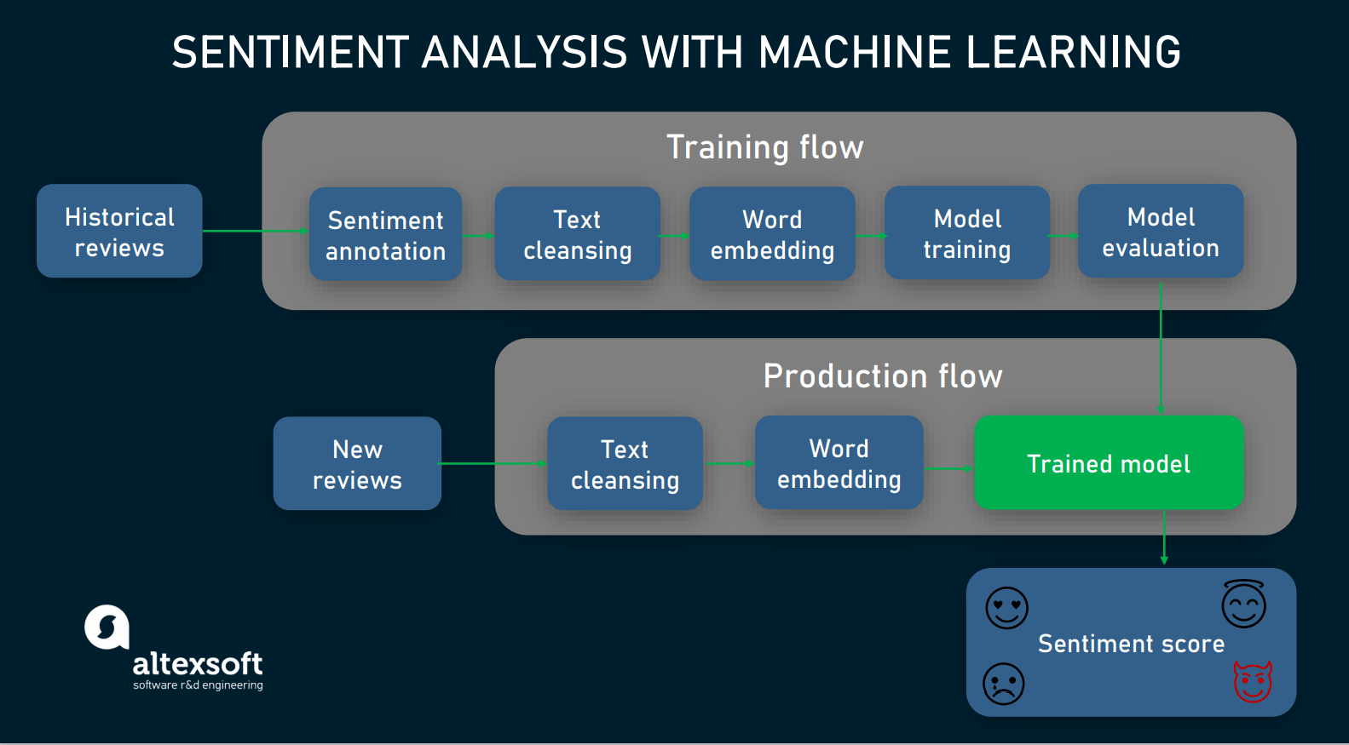
Project Architecture

Slide 14
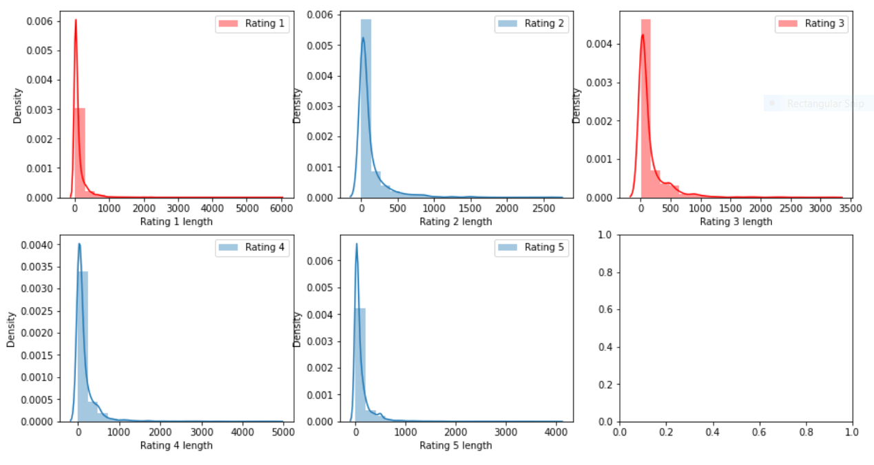
Original Length of text
The length of Original text i.e. the raw text is 25,82,308.

Slide 15
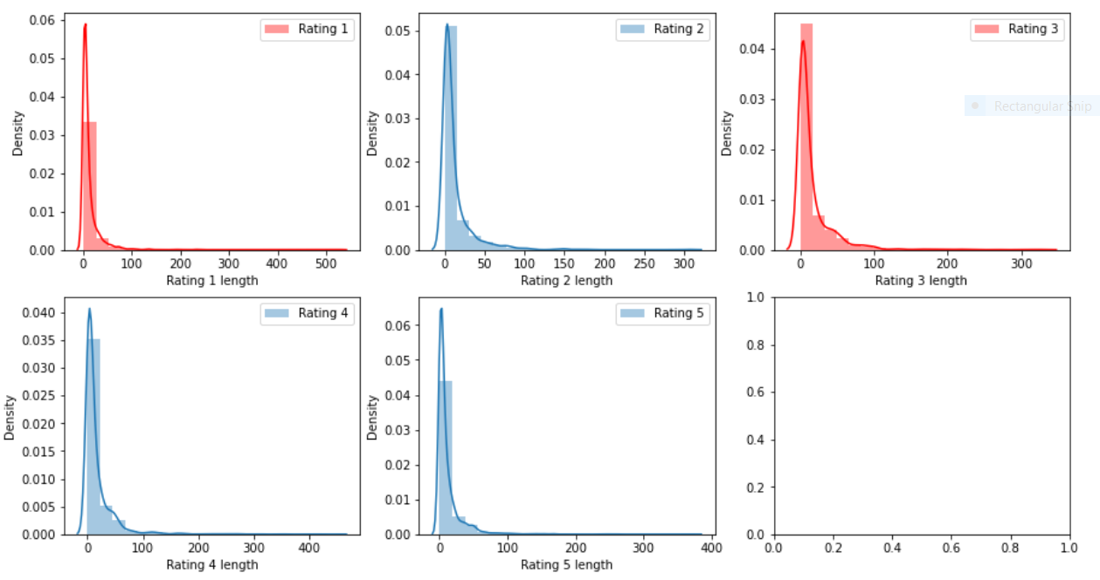
Length of Processed text
The length of text after data processing is 2,67,798

Slide 16
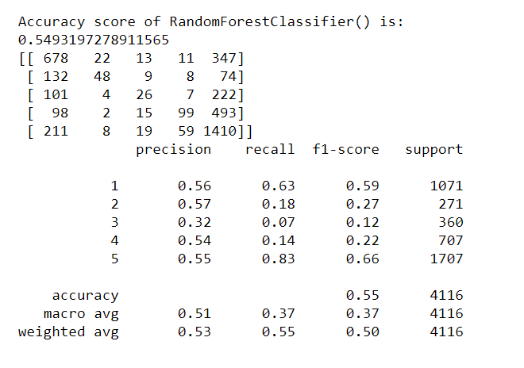
Accuracy of Best Model

Slide 17
Drawback & Limitations
The biggest drawback of this project is that it was not possible to attain the best accuracy with the data that was scrapped because of the imbalanced nature of data set .
Best accuracy can be attained only with balanced data.
Use of Sampling Techniques cannot be made in case of text classification since, making using of it can distort the data.
Hence, to overcome this issue, more data can be scrapped and attempt of scraping data should be made in such a way that there are equal classes for each rating class.

Slide 18
Thank You..!

